Slide 1


Slide 2
About us
Illum Advertising FZE is dedicated to bridging the gap between clients and suppliers. The aim is to provide comprehensive support for all their branding and marketing needs, leveraging the wealth of experience and goodwill cultivated over the years.
The unwavering commitment, hard work added with a rich experience of close to three decades have not only earned me the trust of my clients and suppliers but also inspired me into incepting Illum Advertising FZE.
Our Services
Our proficiency extends from crafting small tabletop displays to orchestrating complete store fit-outs.
We specialize in utilizing various materials such as MDF, acrylic, metal and corrugated FSU. We offer a comprehensive suite of services including window branding, mall kiosks, shop-in-shop concepts, in-store branding and dynamic in-store activations.
With ongoing support from our diverse range of clients and their respective expertise, we have consistently demonstrated the capability to successfully execute projects across a spectrum of scales.

Slide 3












Our Clientele
Amongst a huge number of renowned brands in the market, there are a few who have shown unwavering support and confidence in conducting business with us.
These distinguished brands and distributors have been our steadfast clients, fostering enduring partnerships over an extended period.

Slide 4
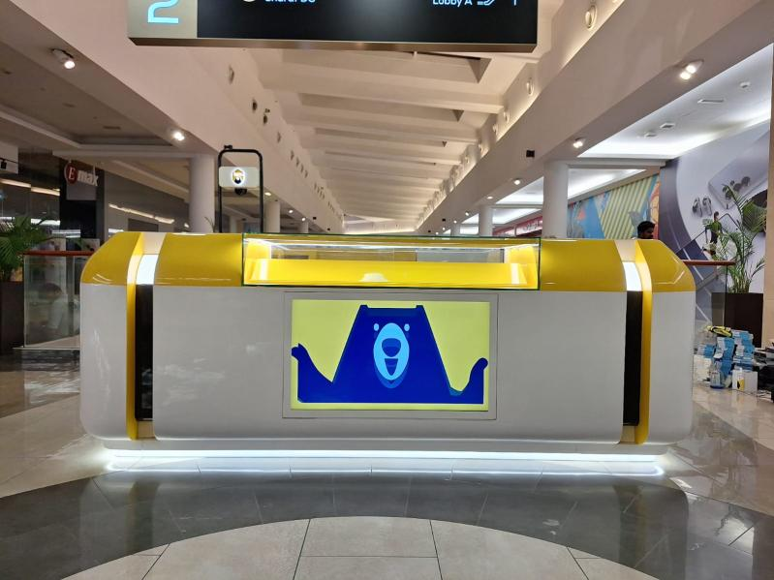
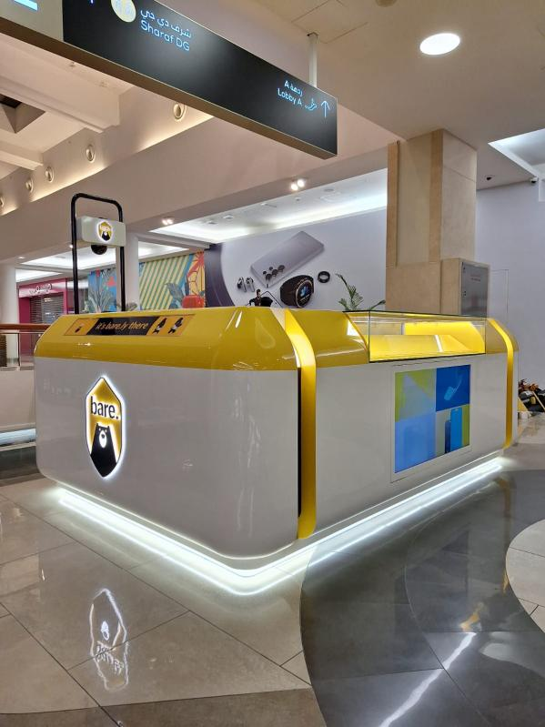
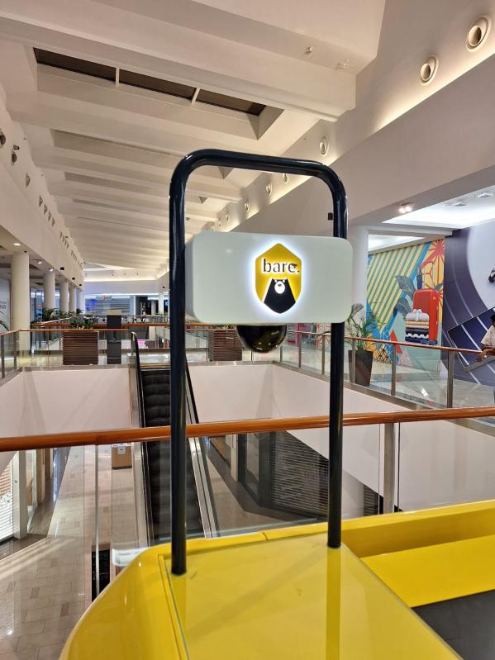
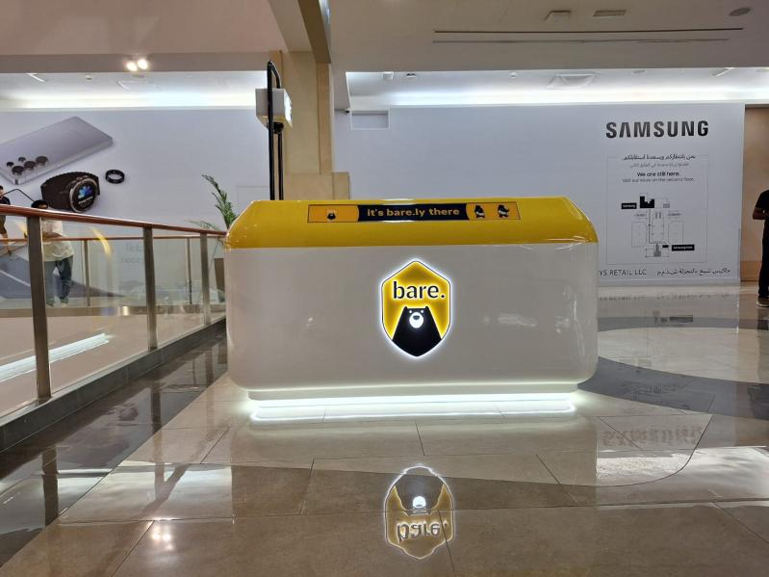
Gallery
Mall Kiosk Rebranded for Aamaal Trading (BARE), Burjuman Mall

Slide 5
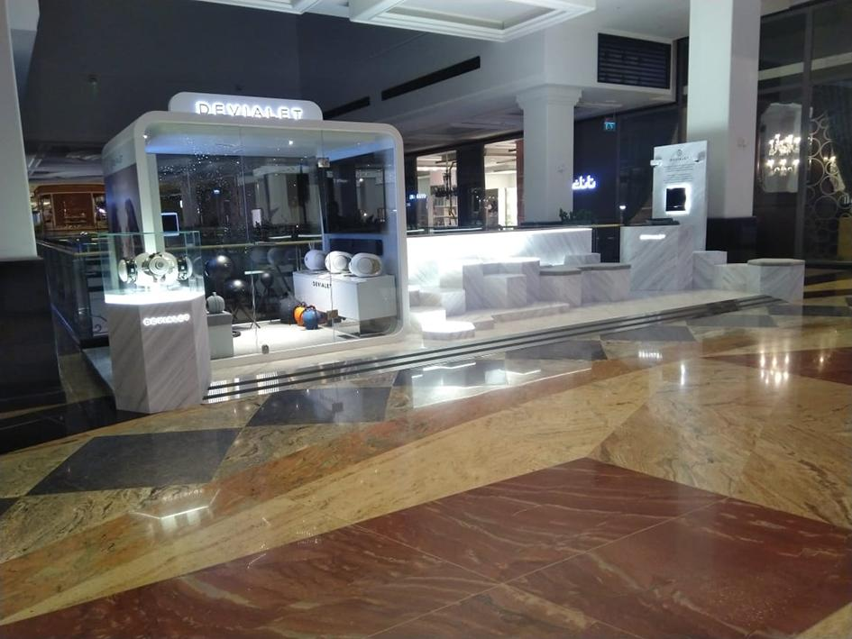
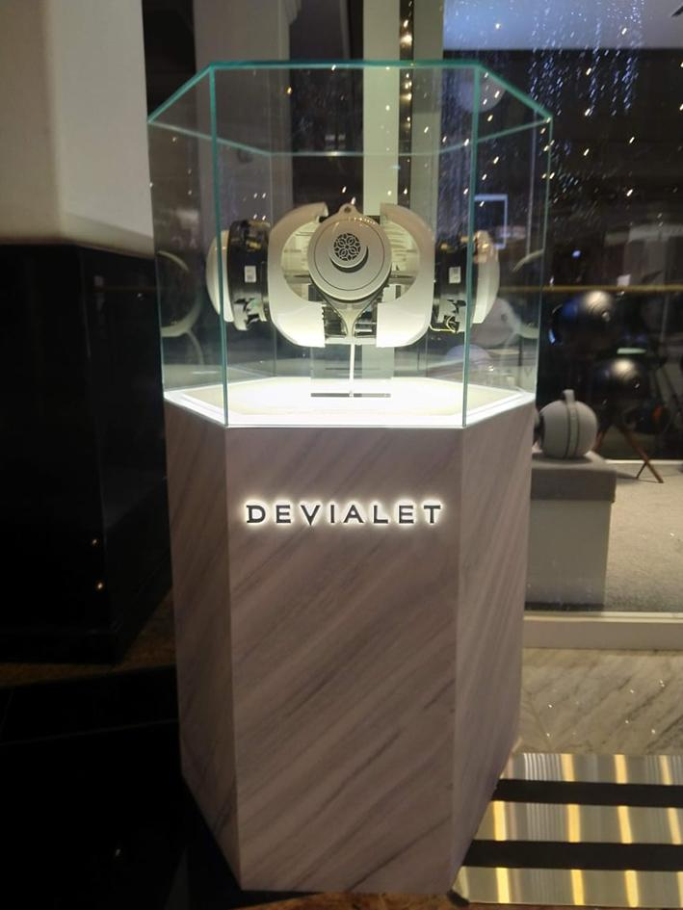
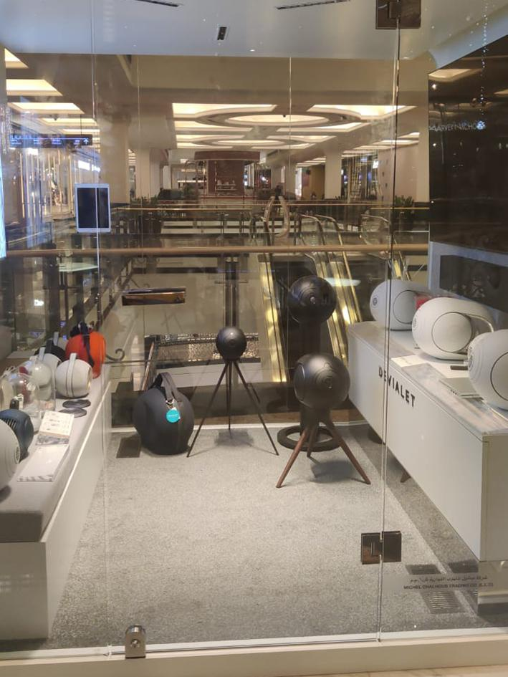
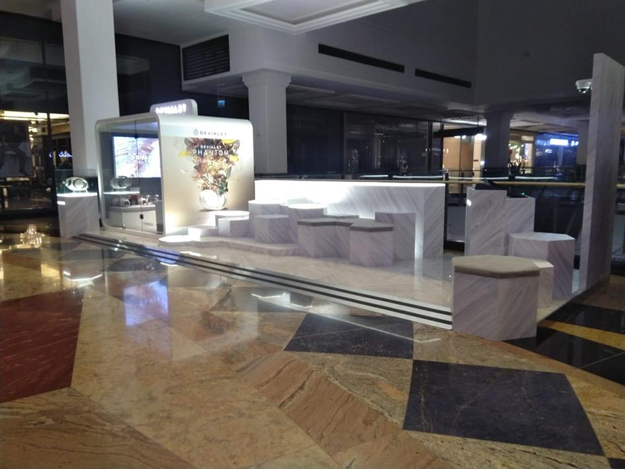
Gallery
Mall Kiosk for Chalhoub (Devialet), Mall of the Emirates

Slide 6
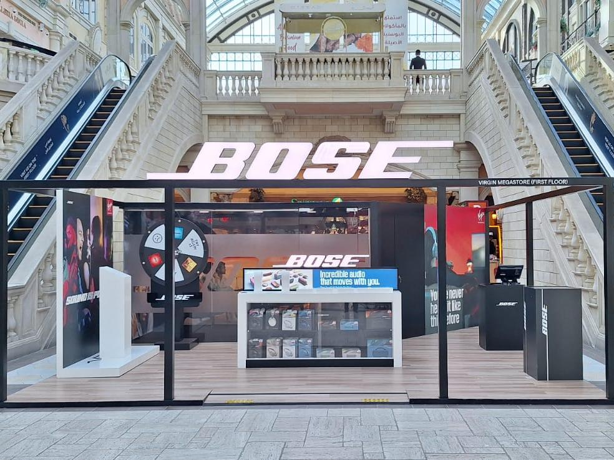
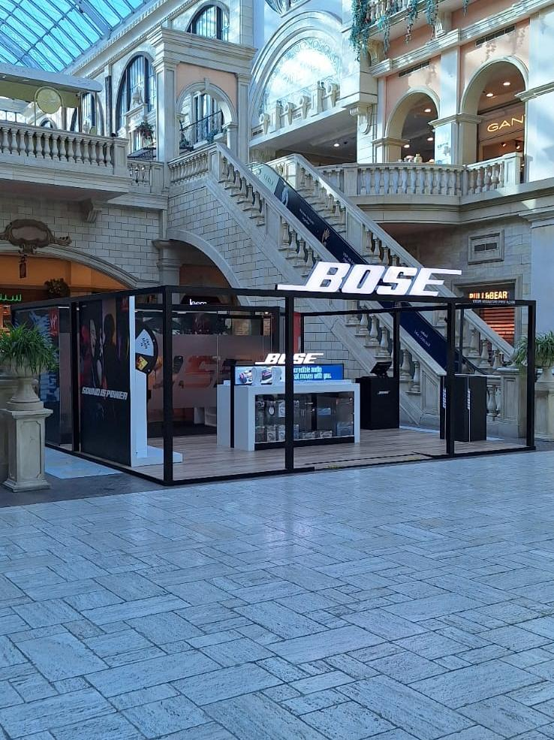
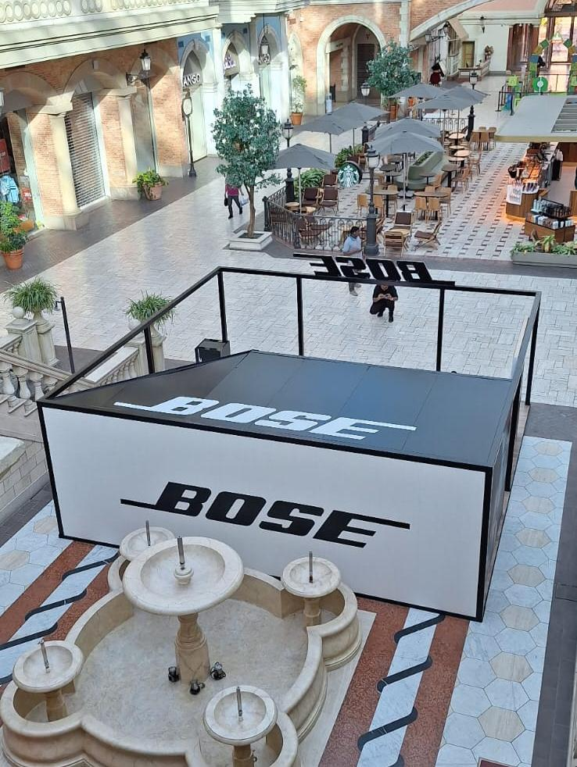
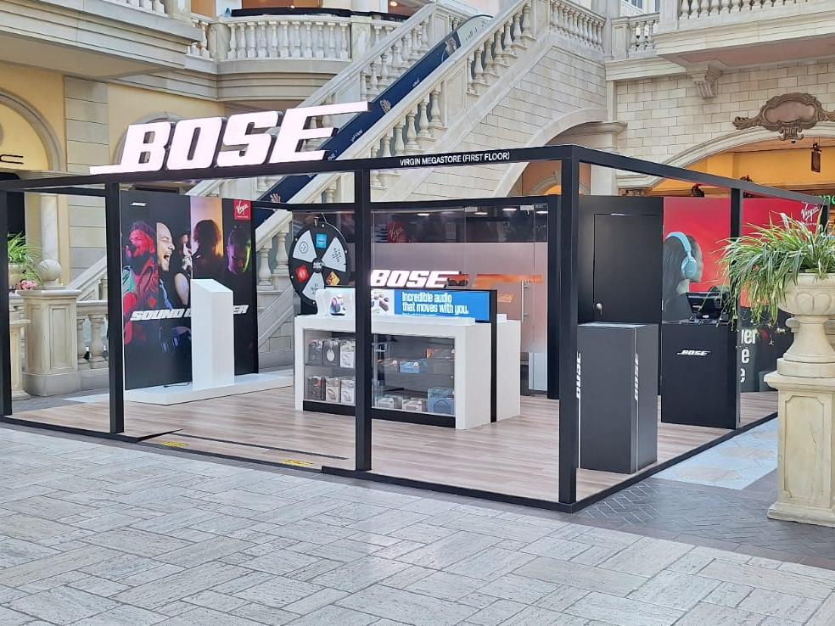
Gallery
Kiosk for Bose, Mercato Mall

Slide 7
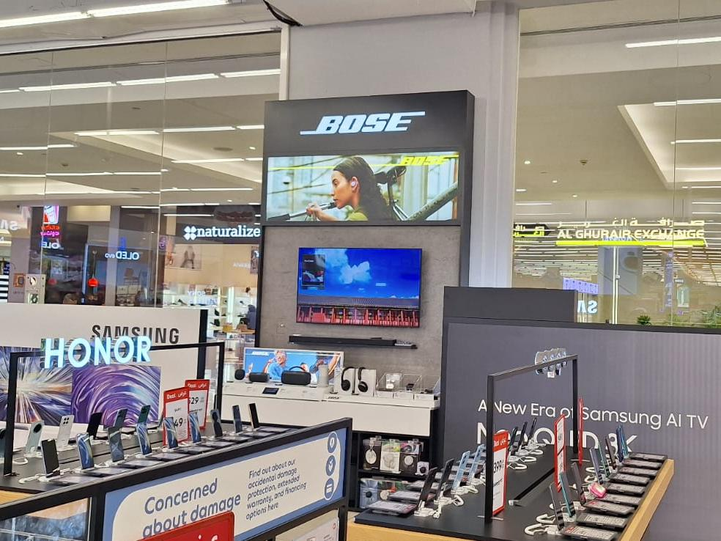
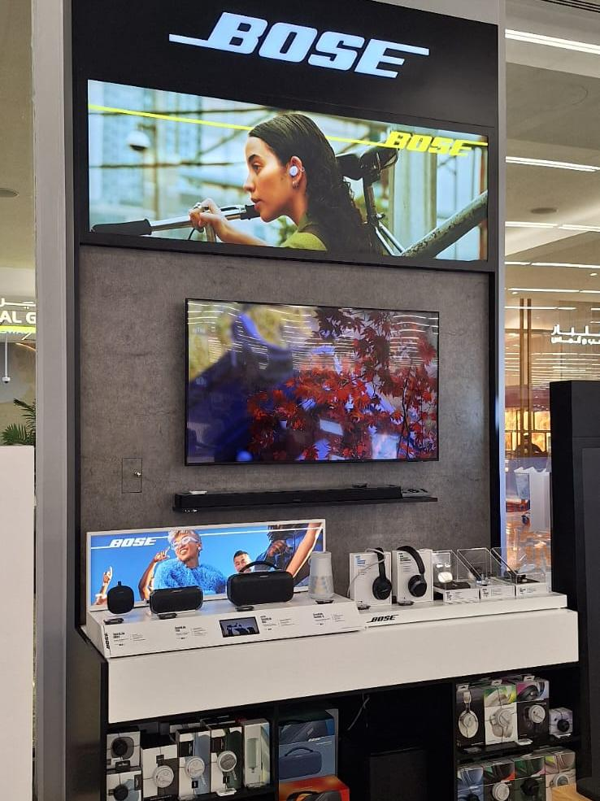
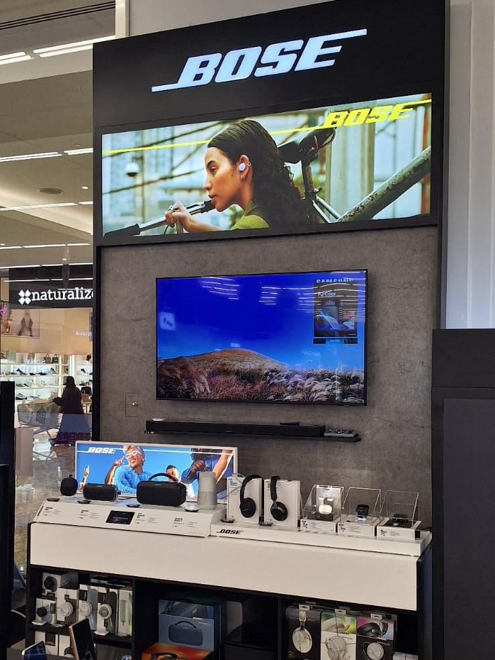
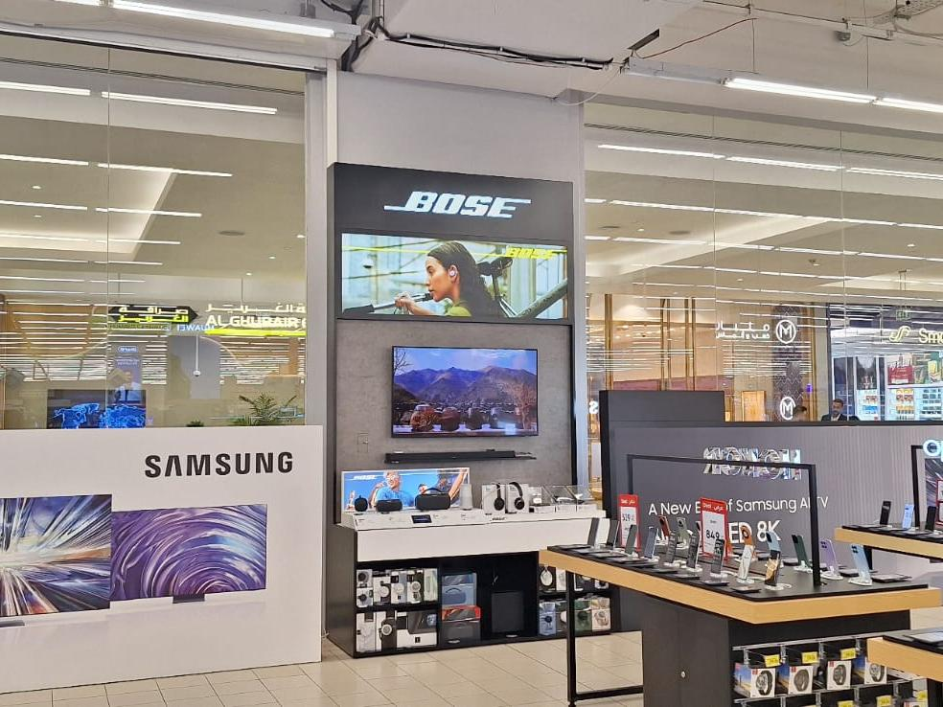
Gallery
Wall Unit for Bose, Carrefour Mirdif CC

Slide 8
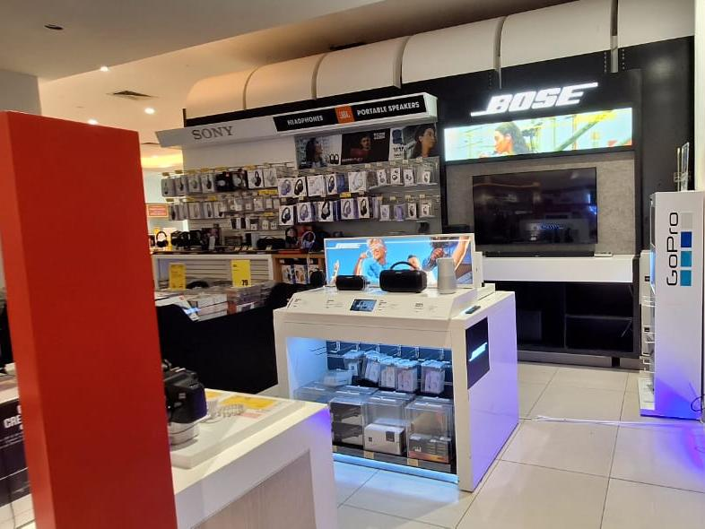
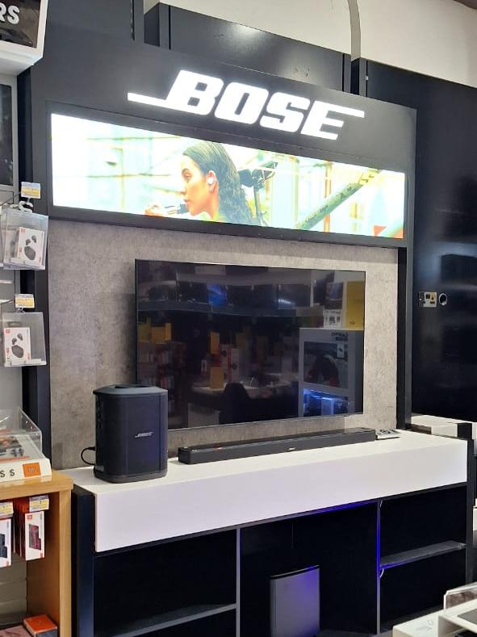
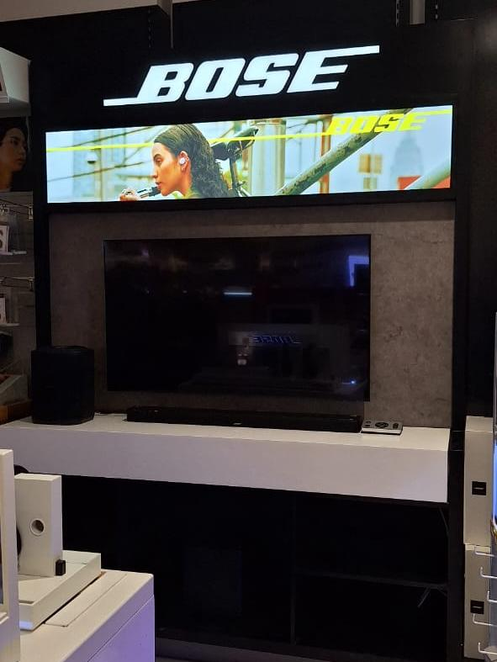
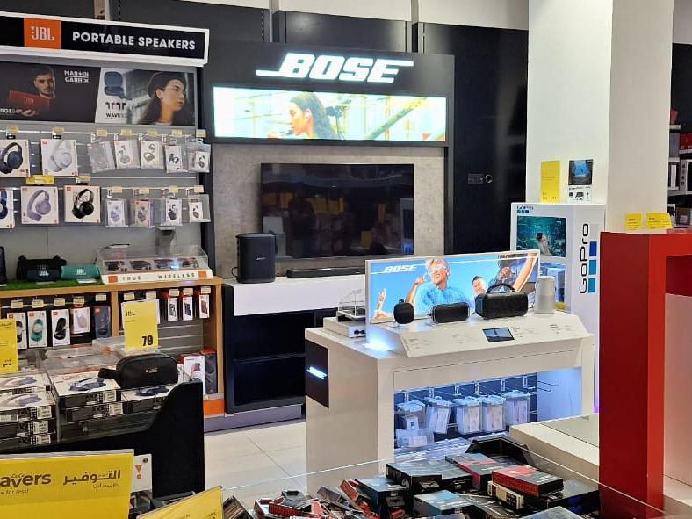
Gallery
Wall Unit for Bose, Lulu Qusais

Slide 9
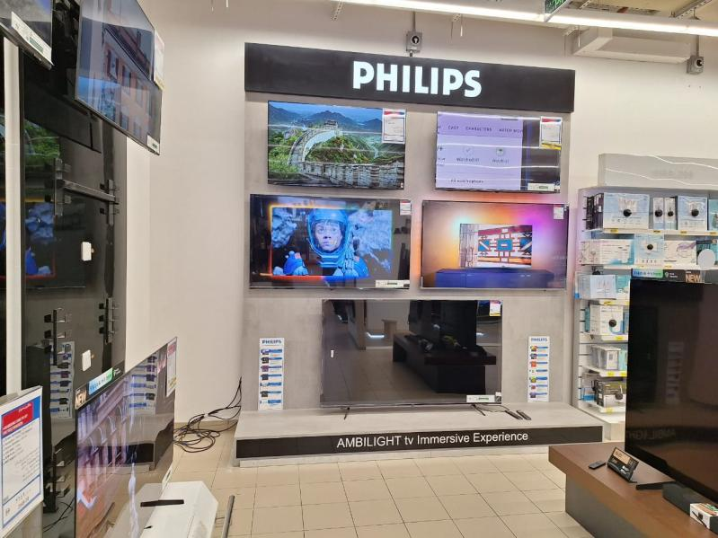
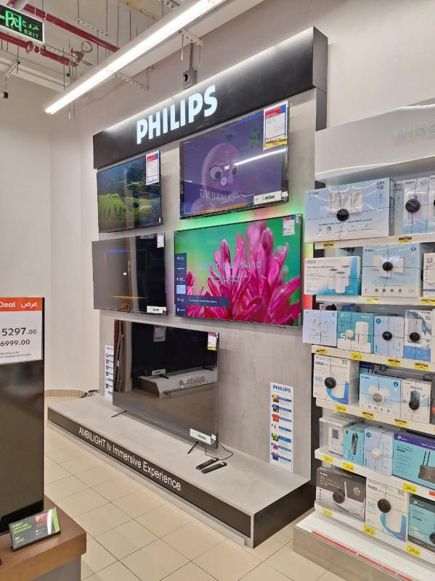
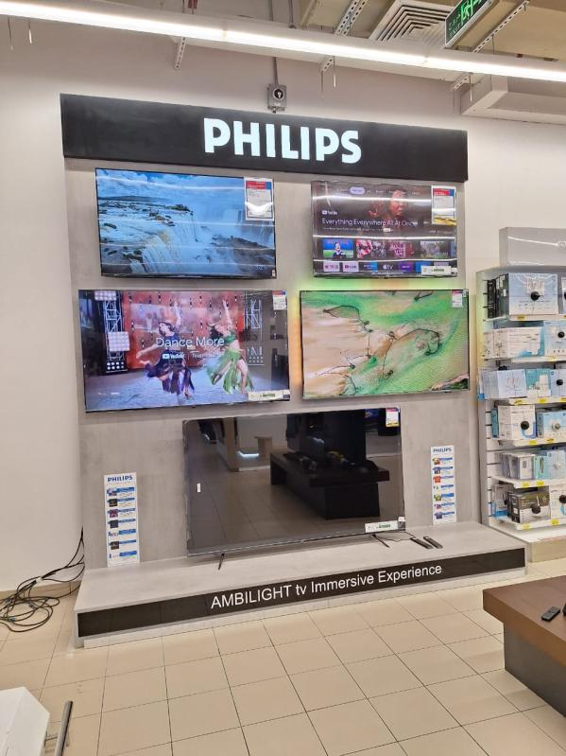
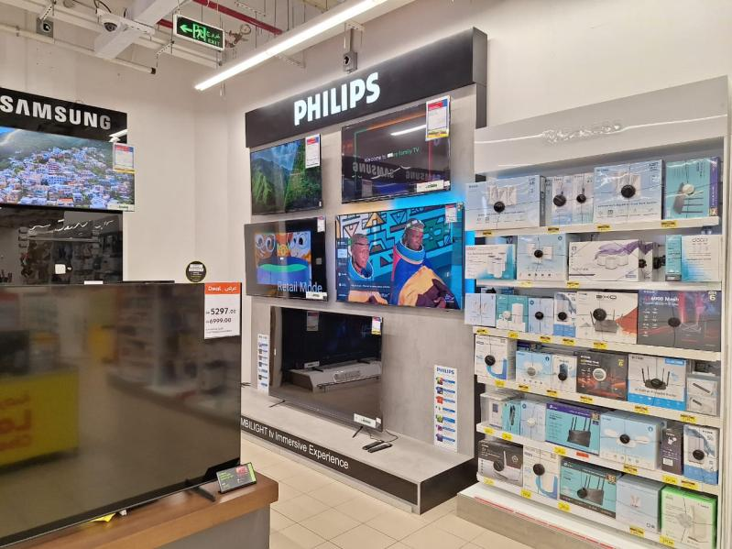
Gallery
Philips TV Wall Unit, Carrefour Al Jimi Mall

Slide 10
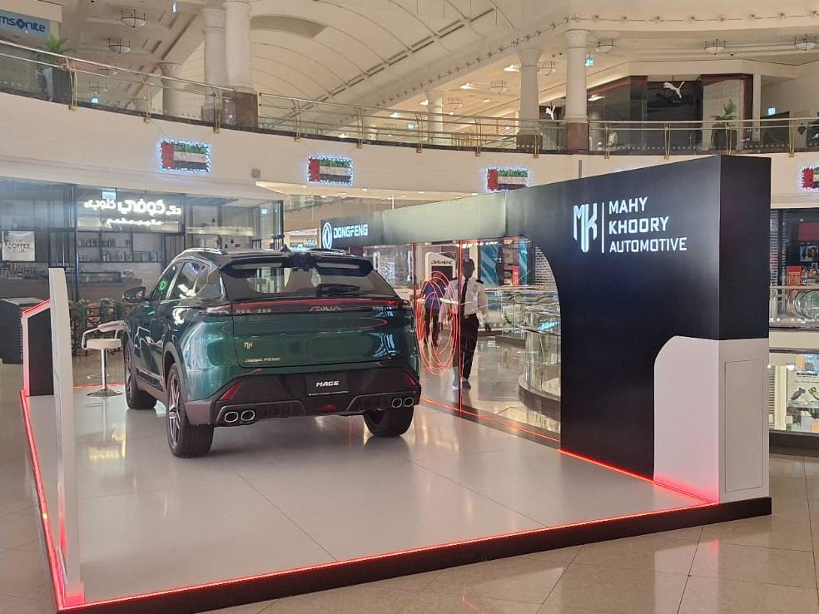
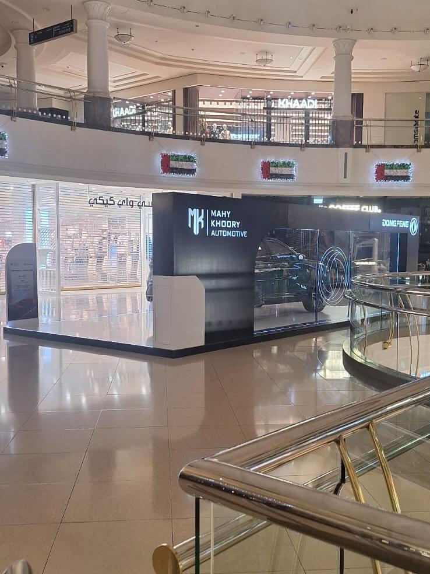
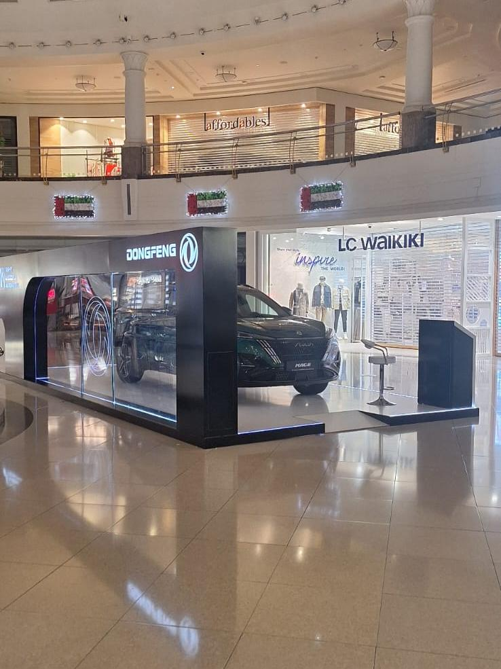
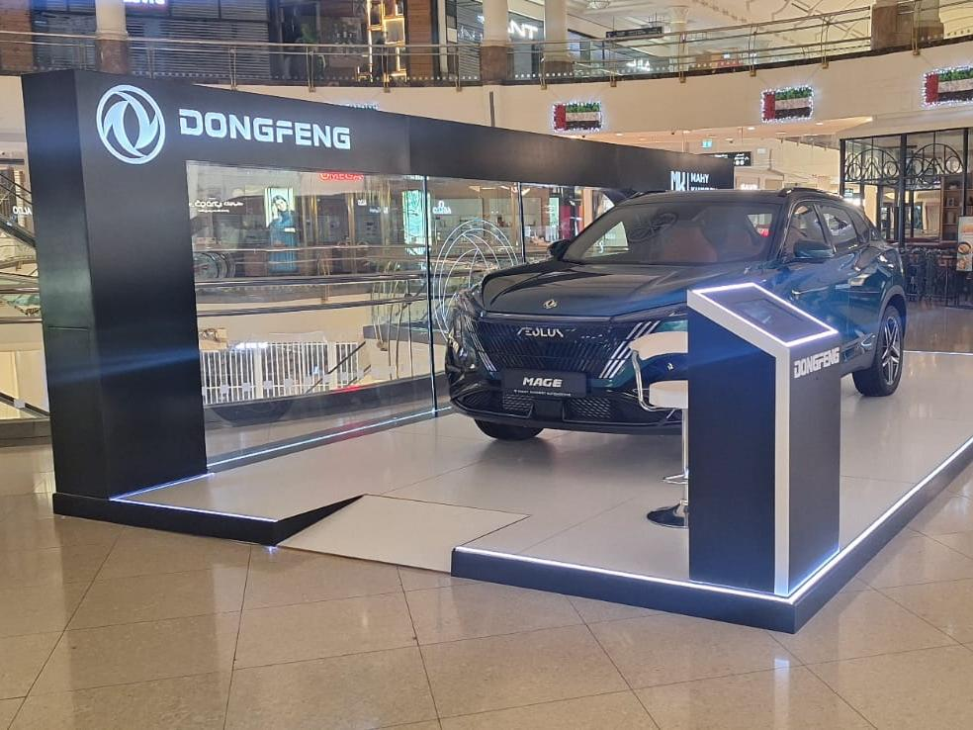
Gallery
Car Display Stand for Dongfeng, Deira City Centre

Slide 11
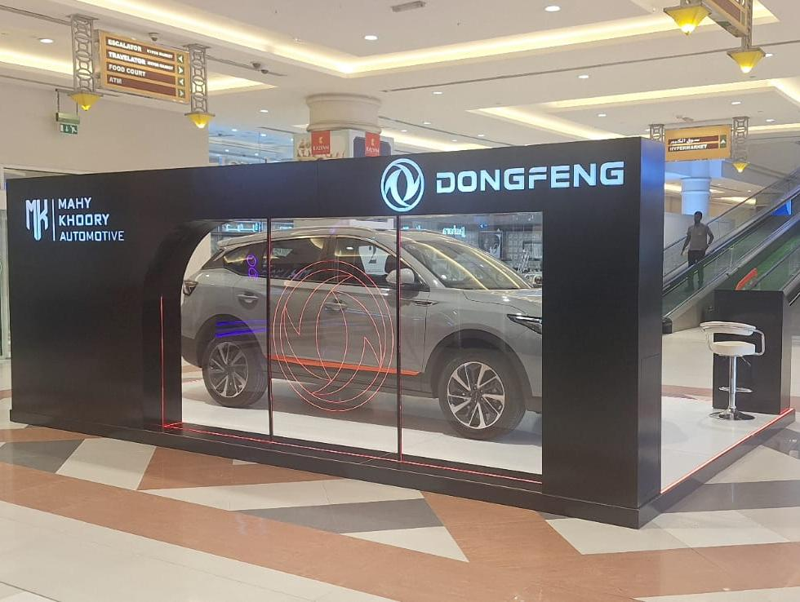
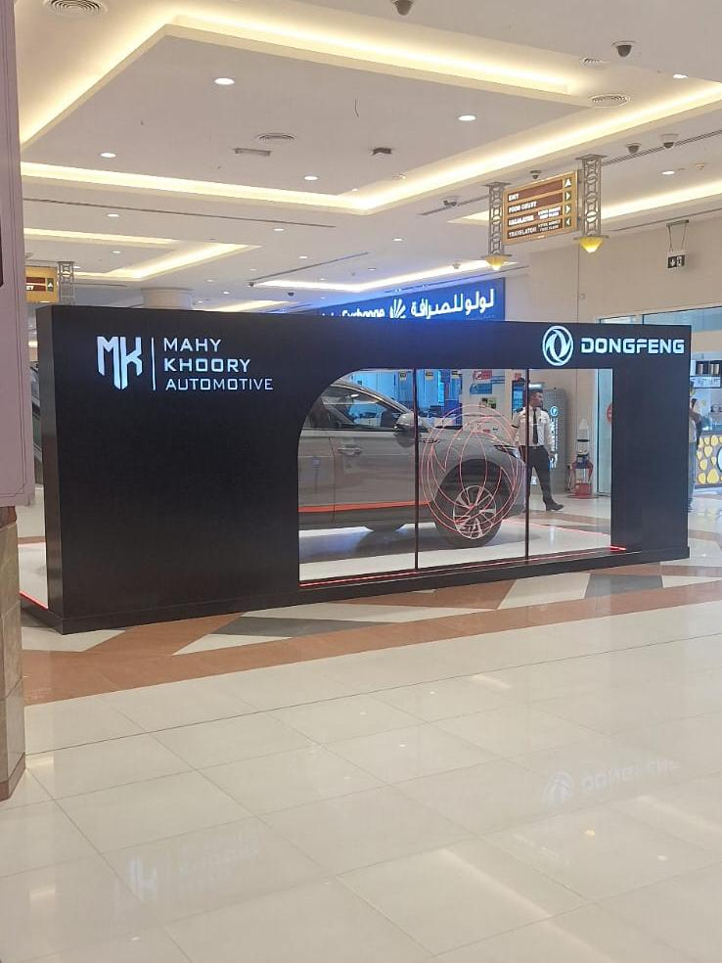
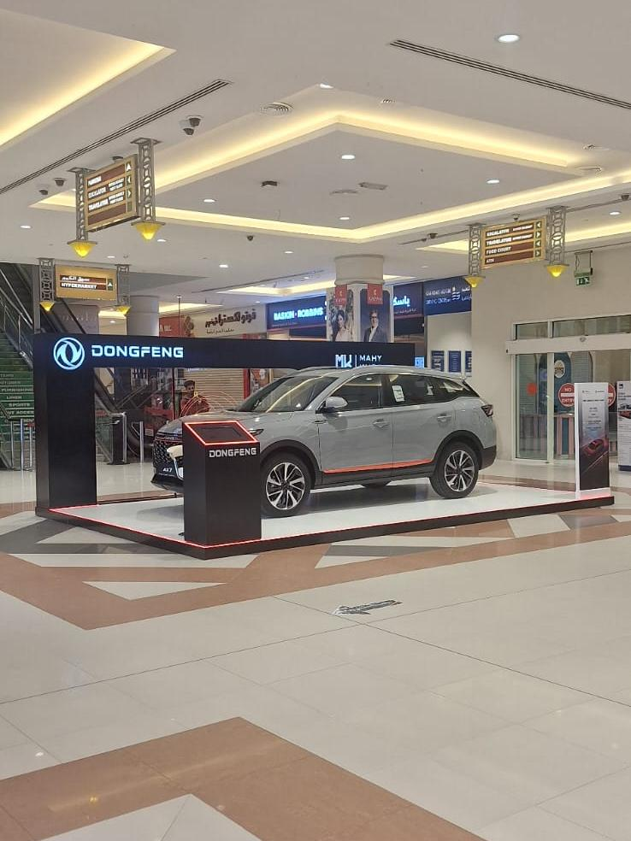
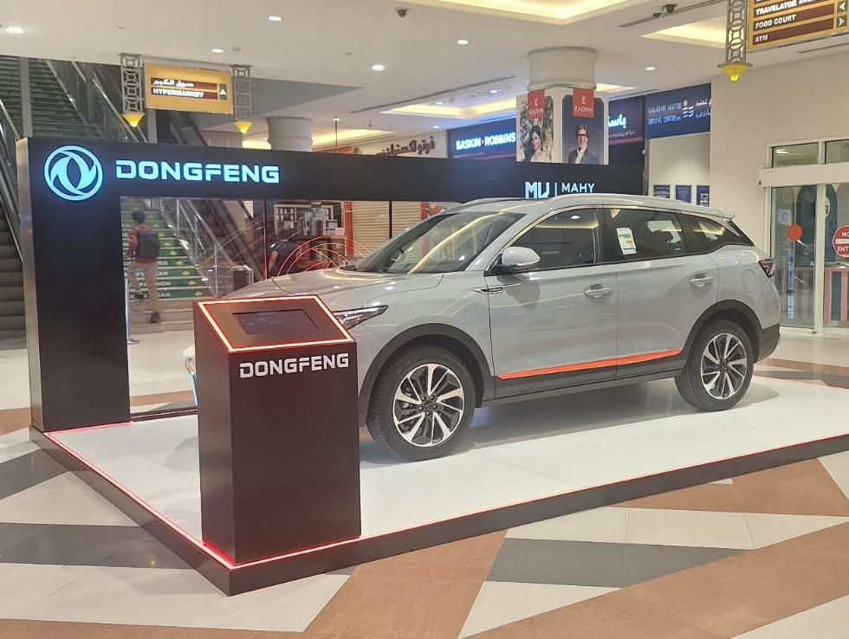
Gallery
Car Display Stand for Dongfeng, Lulu Barsha

Slide 12
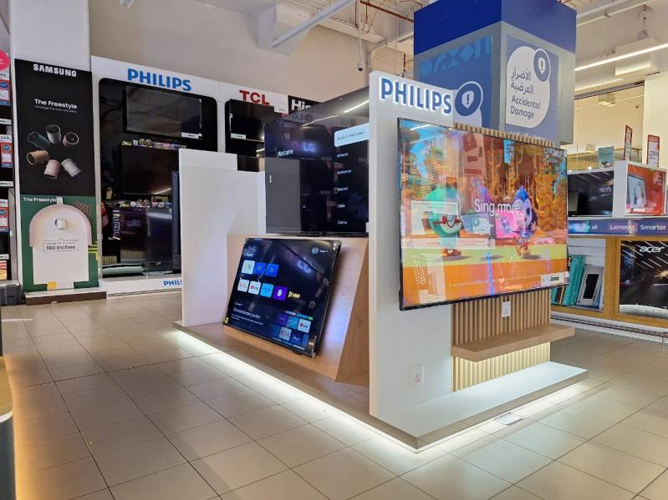
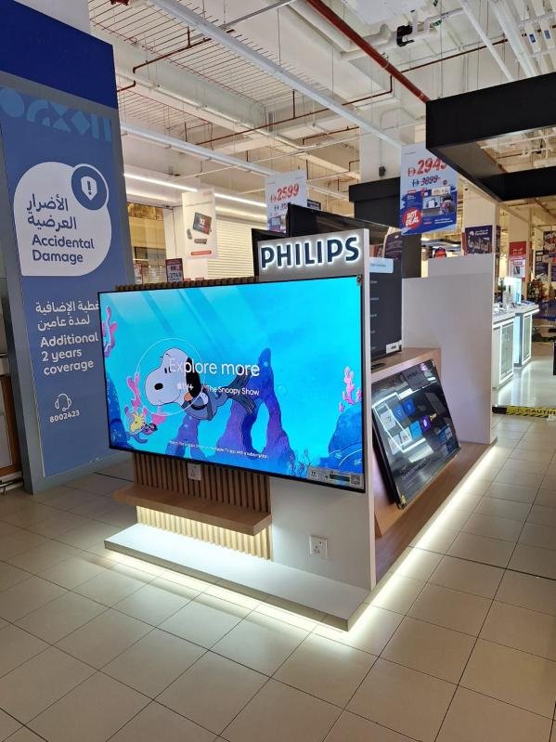
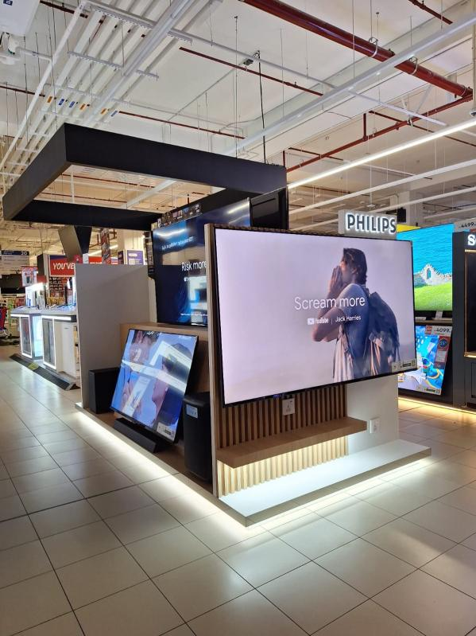
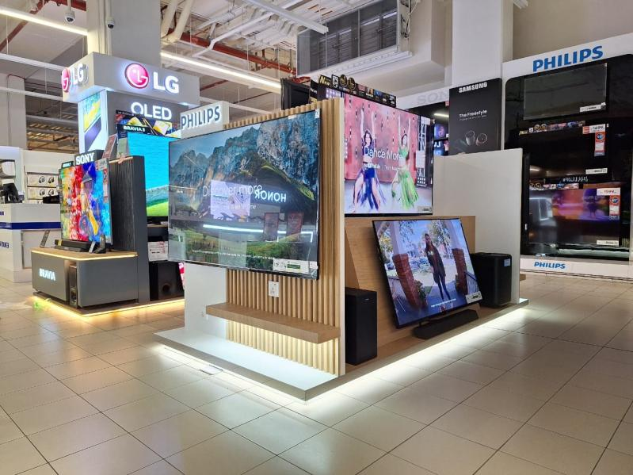
Gallery
Philips TV Island Stand, Carrefour Reem Mall

Slide 13
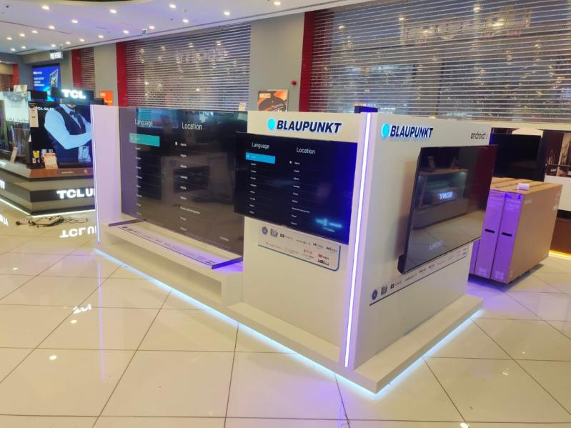
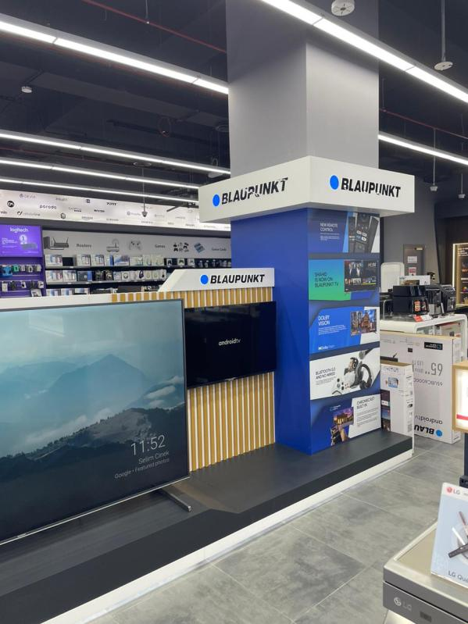
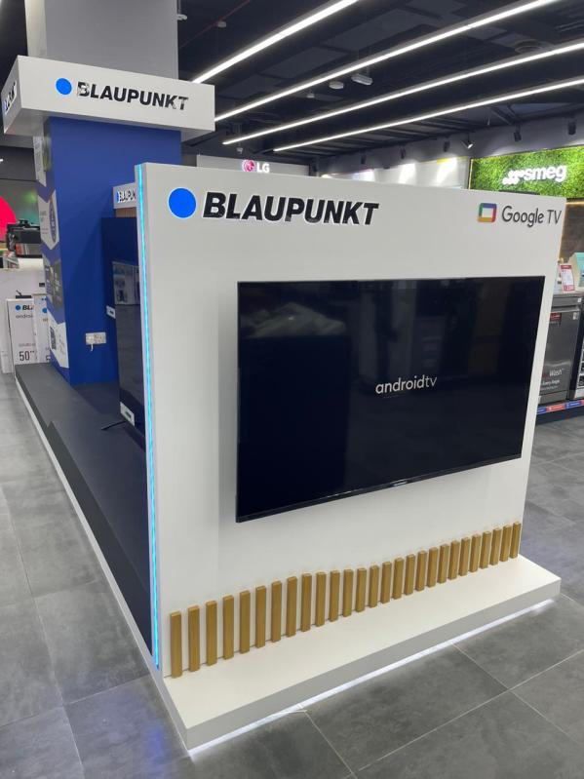
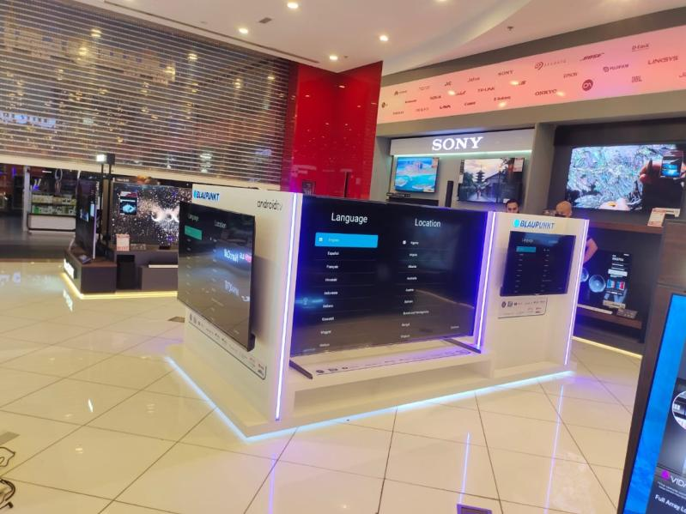
Gallery
Display Stands for Blaupunkt, E-City Stores across UAE

Slide 14
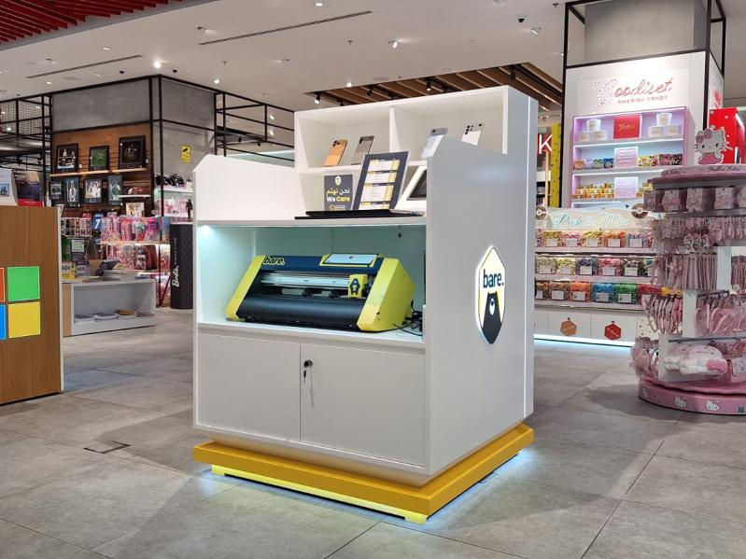
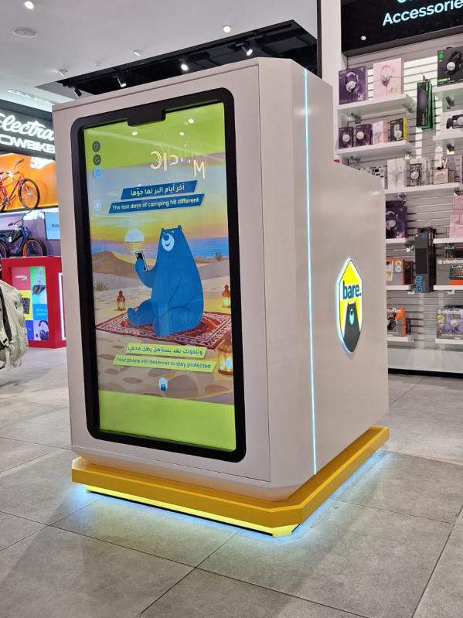
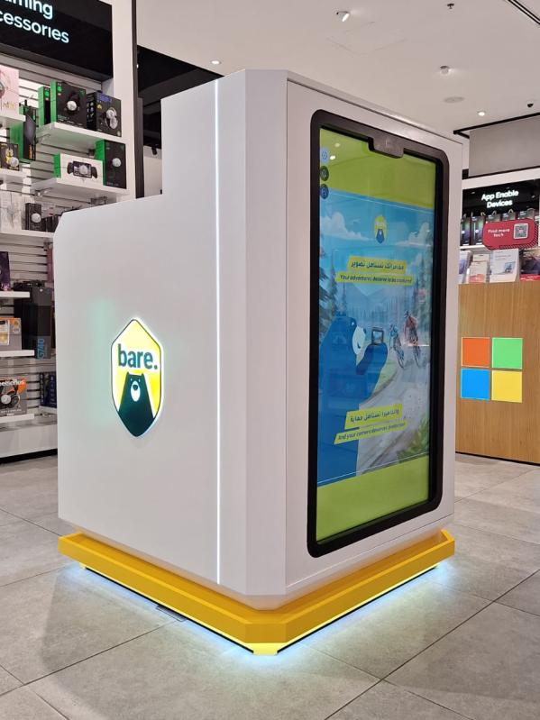
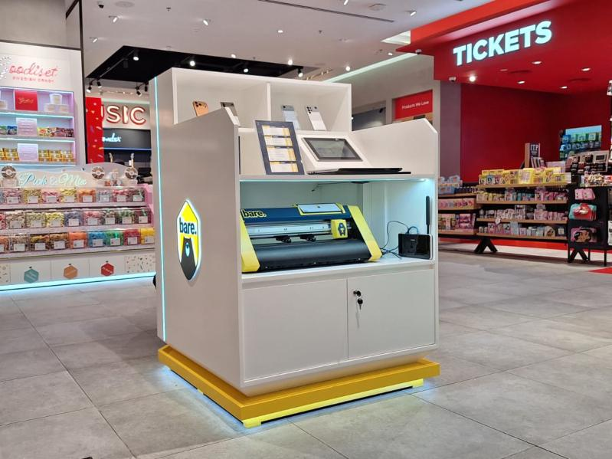
Gallery
Display Stand for BARE, Virgin Megastore Galleria Mall

Slide 15
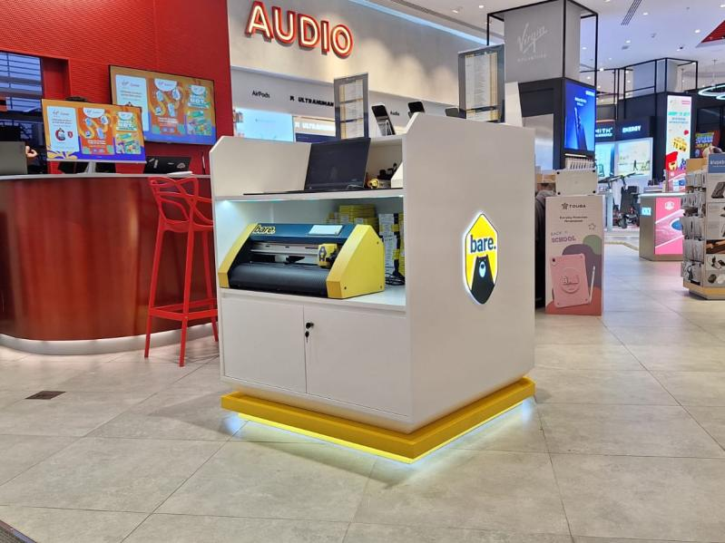
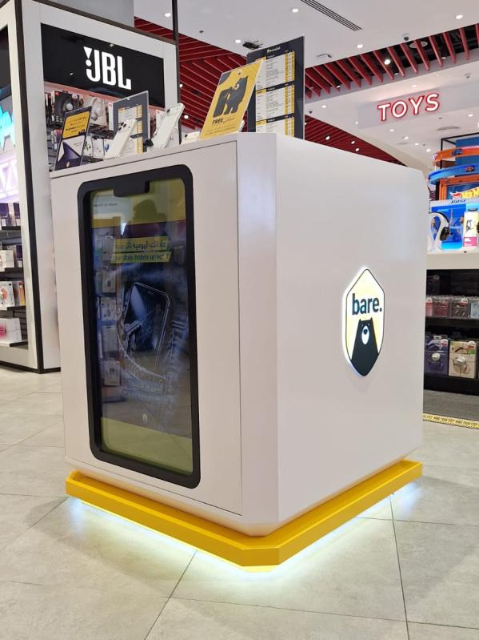
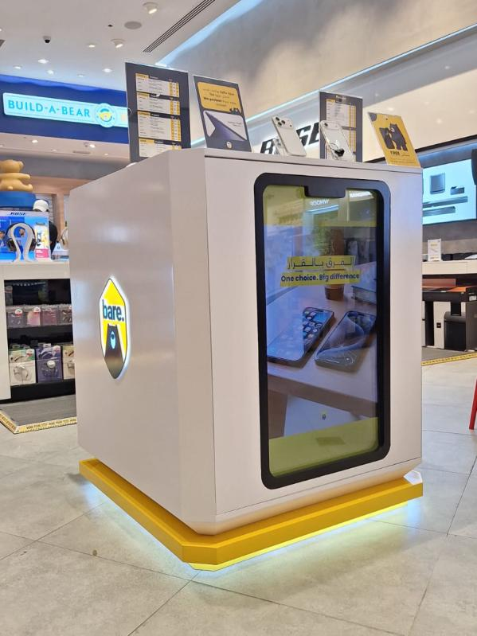
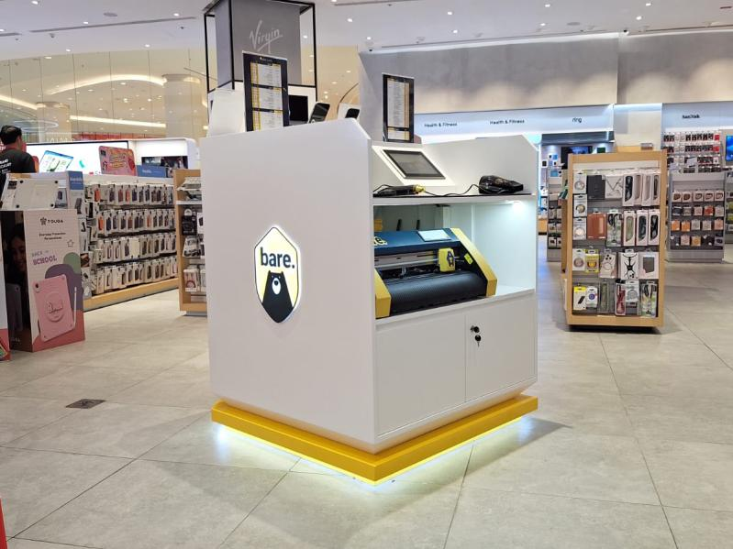
Gallery
Display Stand for BARE, Virgin Megastore Dubai Mall

Slide 16
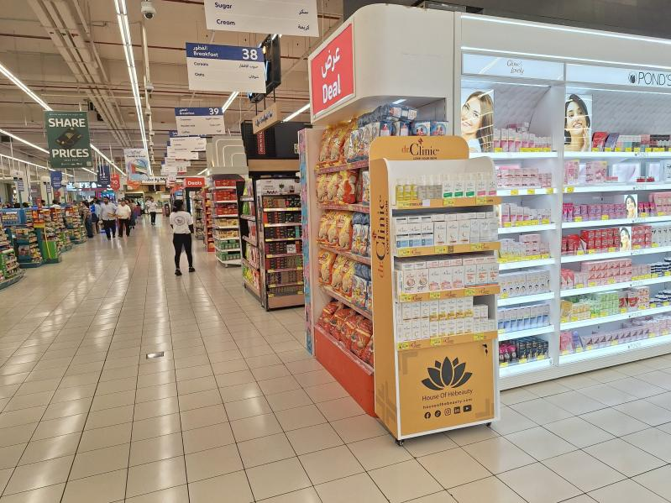
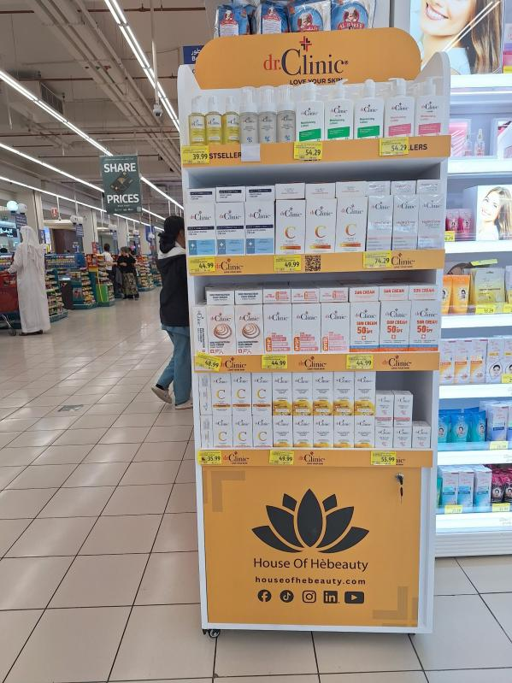


Gallery
Display Stands for Dr Clinic, Carrefour Stores across UAE

Slide 17




Gallery
Display Stands for Simfer, Various stores across UAE

Slide 18




Gallery
Display Stands for Simfer, Various stores across UAE

Slide 19




Gallery
Exhibition Stand for Nutridor, Future Food Forum 2024

Slide 20




Gallery
Lightbox Header for Yale, ACE Dubai Festival City

Slide 21



Interactive Concept Videos

Slide 22



Please feel free to get in touch:
+971 50 745 7629 / +971 54 406 7852
mufaddal.t@illumadvertising.com
www.illumadvertising.com

Slide 23
THANK YOU

